Slide 1
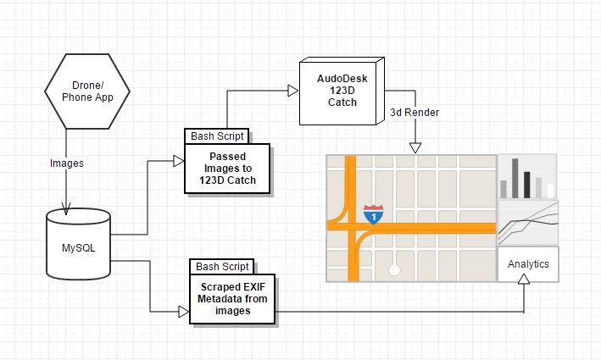
Server Infrastructure Overview

Slide 2
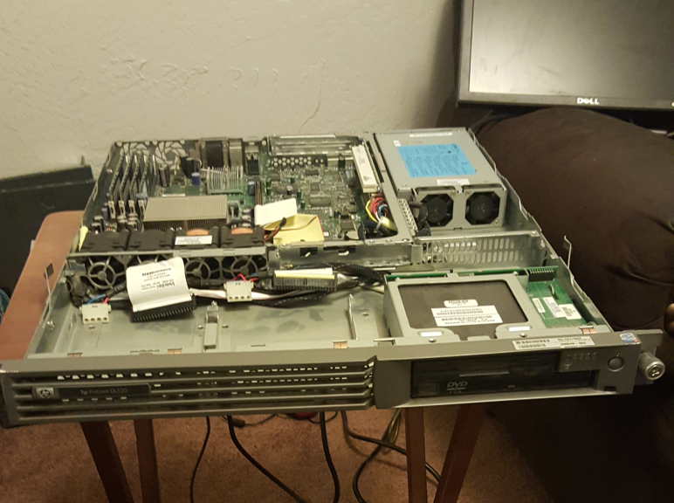
Primary Database Server
Running Xubuntu 15.10
Uses MySQL to hold the images
Uses several bash scripts
to process the images
HP ProLiant DL320

Slide 3
Server Side Code
Formats images to a uniform size
Scrapes image metadata
Enforces image naming conventions
Creates a master content list
Passes images to Autodesk 123D Catch

Slide 4
Autodesk 123D Catch
Creates 3D objects using a large set of images
Originally we created a system using ImageMagick and Javascript
Now we record video with the phone and scrape images from it using VLC Player

Slide 5
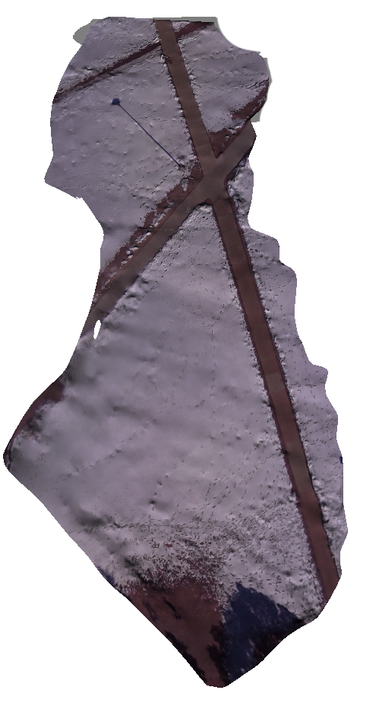
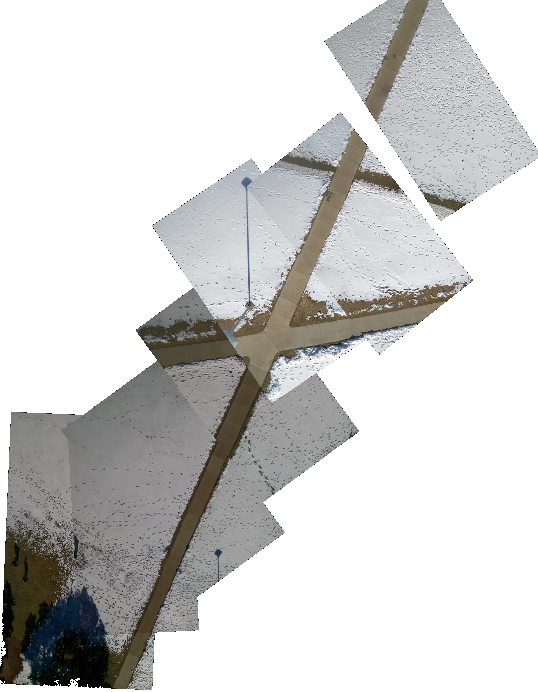

Slide 7
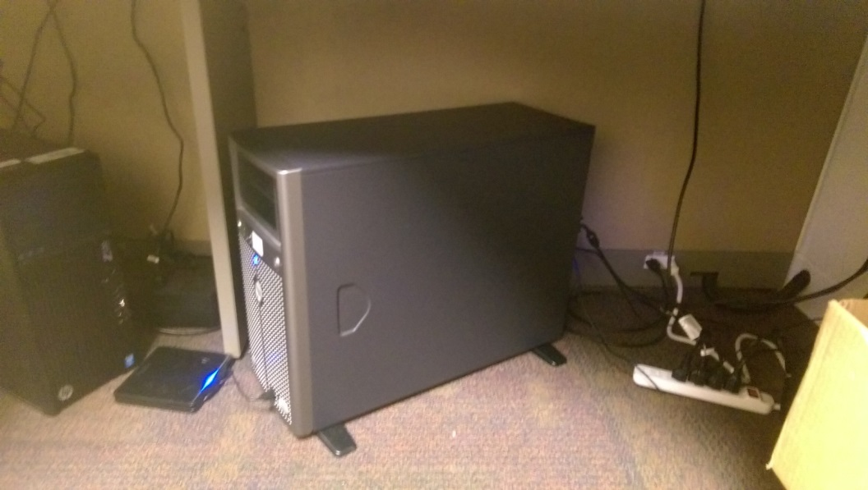
Website
Using Bootstrap, Ajax and Javascript
Acts as a hub for all our public facing systems
In the future, directly tie into the app

Slide 8
Analytical Information
Using data both from the drone’s flight path and from the phone we can run high level analytics.
Average speed, estimated distance between images, GPS information
Could be compiled into an automated report to emailed after each flight

Slide 9
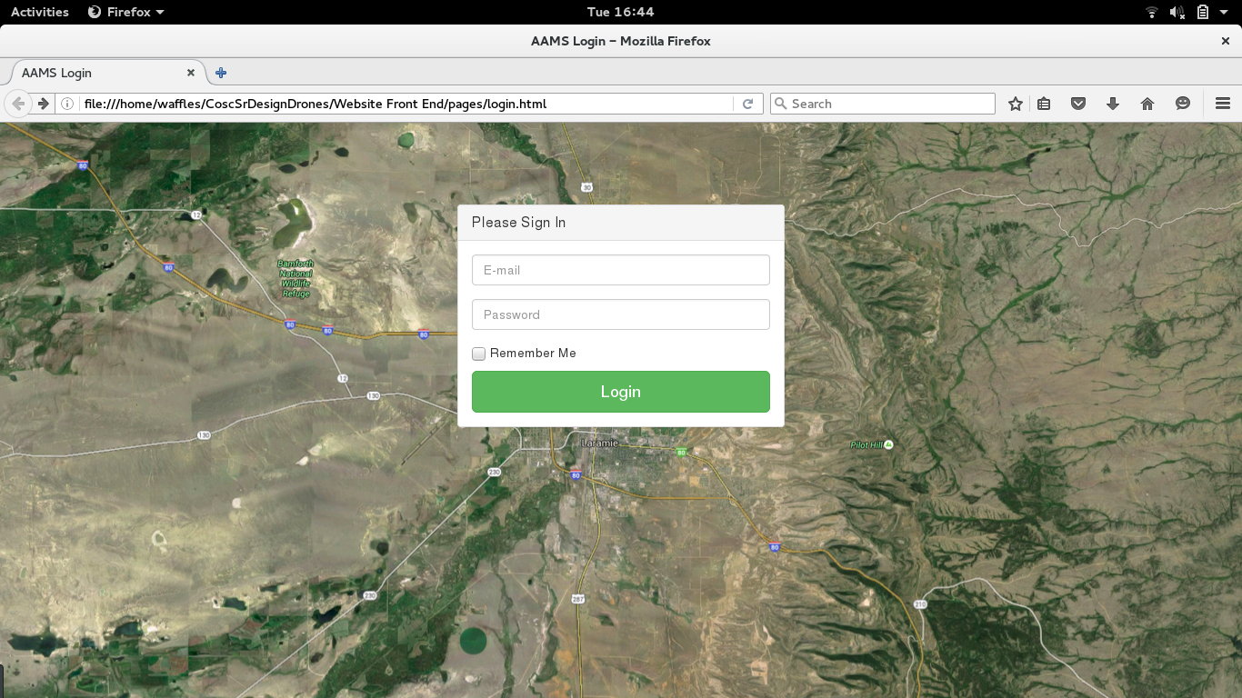

Slide 10
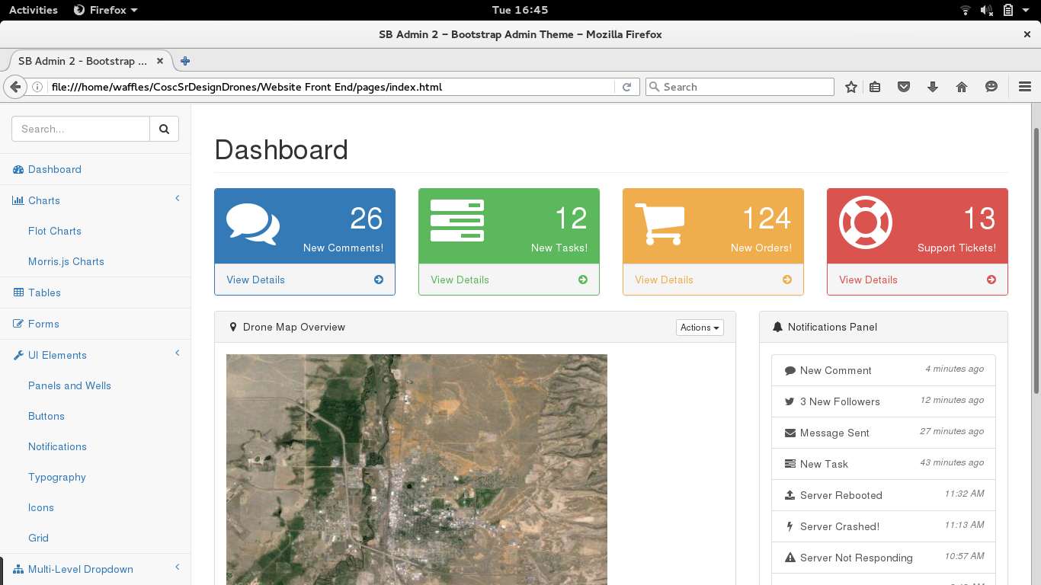

Slide 11
Future Improvements
Low cost hardware upgrades
Move our hardware to the cloud
Automatically generated reports
Camera stabilizing mount
Real time video rendering

Slide 12
Q&A?

